Slide 1

Introducing The Family Bank

Slide 2
AGENDA
Stakeholder analysis
Support clusters
Designing messages for clusters
Family members’ decision journeys
Communication plan short term
Communication plan up to 1 year
Notes:
We’re going to think of how best to introduce the family bank by listing everyone, their anticipated level of support, and their potential concerns. From there we’ll make clusters based on family members who feel similarly and then we’ll design communications to meet them where they are at. Then we’ll make a plan of how to introduce the family bank, and make a longer term plan for keeping your family updated and engaged with the bank

Slide 3
What objections might you encounter in telling your family about your plan to start a family bank?
What does your family currently think and expect for how you will pass on your wealth? How will they feel about the change?
Notes:
Here’s two general questions that you should think about to guide your strategy for communicating your plans with your family. The more that you can anticipate your family’s reaction, the better prepared you can be to offer reassurance and help them understand your motivations

Slide 4
Who are the stakeholders?
List everyone who should have a say in the family bank
What’s their likely first position (against the bank, won’t care about it either way, neutral, supportive/committed)
How involved do we expect them to be?
Anticipated issues/concerns?
Motivations- what does this family member need?
Influence level - do other family members follow their lead?
Context
Notes:
Where do you think each person is likely to sit when you first tell them about the bank?
Involved meaning how active will they be in their opinion. For example, if they are positive, but not involved they aren’t initially that useful as a supporter but could be moved to being more involved
or if they are negative and likely to be very involved, that person could quickly become a hindrance to what you’re trying to achieve
What concerns are your family members likely to have? is someone thinking “gee, I wanted that inheritance to pay for my kid’s college” What reassurance will be needed?
we ask this to identify leverage. Let’s say someone really cares about fairness, they could be told that the bank will be more fair than inheritance and that could motivate them to change an opinion
influence level: do we think this person’s opinion sways others?
Context: we don’t need the full history but are there past events that might pre-influence someone to be less supportive or more supportive? how are they entering this discussion. what past hurts might surface?

Slide 5
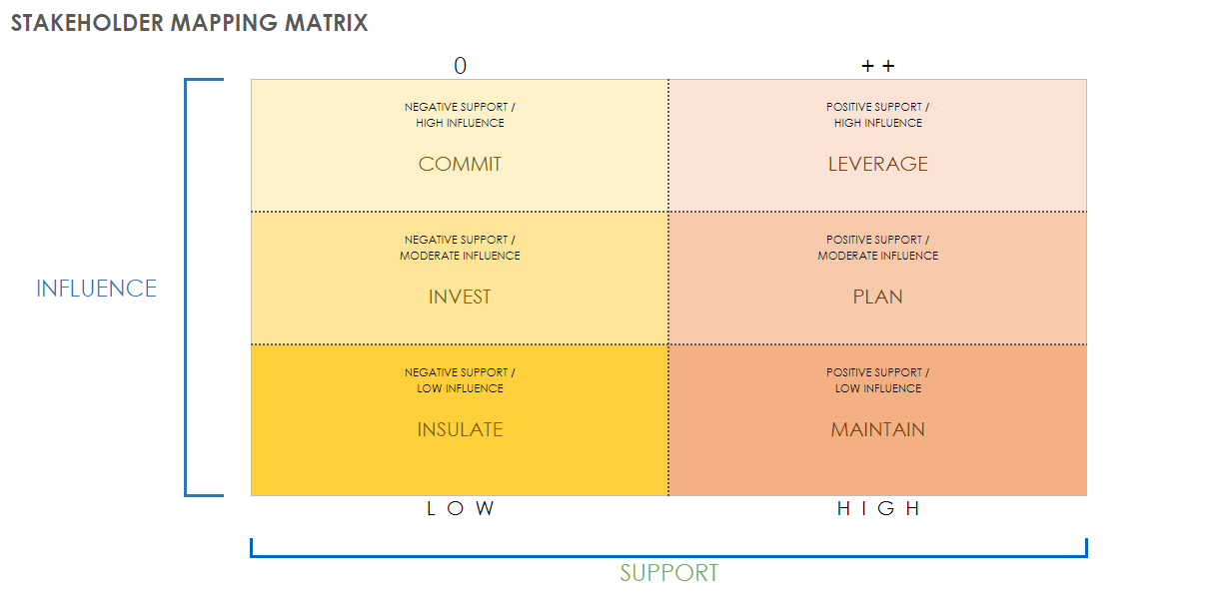

Slide 6
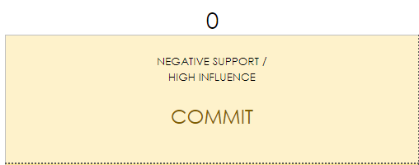
Cluster messages
  This group has the potential to slow down the family bank if not managed properly
  Goal: Overcome objections enough that they are not taking action.
  Key Messages:
    “I know this wasn’t what you wanted or expected, is there a way I could prove the benefits to you?
    “I don’t expect you to be 100% on board, but would you be willing to hear more about it?”
    “I really care about how you feel about this and I know [ speak to key motivation] is important to you, how can I make this better for you?
  Avoid: ignoring or excluding.
Notes:
This is a tough group. You don’t want to spend all your time trying to convince naysayers that they are wrong. You are not going to be able to turn everyone into allies , at least not right away. Instead, focus on taking down their level of action. You need to understand their objections and connect with them. What you’re asking them to do is not change their mind but just pause a little bit.
here’s some sample ways to reach out. we’ll write you more customized messages later that speak to the concerns you shared before.
With this group, it’s important to keep them in the loop. if you ignore them, this increases the anger they might feel and gives a justification for others to join their side

Slide 7
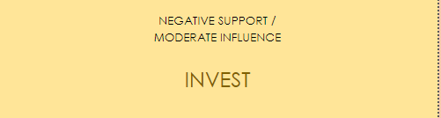
Cluster messages
  This group could become more favorable or more opposed
  Goal: Separate them from the most negative elements, invite to share more
  Key Messages:
    “I understand you’ve got some questions and concerns with the family bank. I would love to hear more about how you feel”
    “It seems like you have a problem with [ objection with the bank]. Can we talk more about it so I can understand what you’re thinking?”
    “What would help you to feel more interested in the family bank?”
  Avoid: Misunderstanding their concerns
Notes:
This group could go either way in supporting your bank. If they feel sidelined and misunderstood, they could join the detractors camp. You want to bring them into the fold by demonstrating care and understanding. They likely won’t become your bigger supporters but they will be easier to move than your most opposed family members. When they move, others might follow their lead.

Slide 8

Cluster messages
  This group isn’t your top priority. They mostly will neither help nor hurt
  Goal: Move to be passive support
  Key Messages:
    “If you’re interested, I would love to explain how the bank could help you out”
    “I know the family bank seems like a lot of set up now, but it’s going to get easier to use soon. Do you want me to show you how to use it?”
    “I appreciate the time you’ve taken to hear me out”
  Avoid: Asking too much of this group
Notes:
Marginalize isn’t exactly right here. but the idea is that This group still matters but you could spent a lot of time trying to convince them and it might not change the whole group’s opinion all that much. These are lurkers, the’ve heard about it, they don’t really want to be involved. You want to sell them on potential benefits, especially the low hanging fruit that doesn’t demand that they do much. You want to be grateful for the group and their flexibility, this will build into their self image as reasonable people. You don’t want to waste their time and yours by expecting too much from this group.

Slide 9
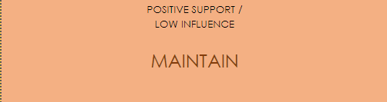
Cluster messages
  This group is nice to have, they can be slowly asked to do more
  Goal: Keep their support
  Key Messages:
    “Thanks for being willing to be part of this, it means a lot to me that you’re here”
    “I understand you’re busy, so I’ll just tell you about the developments that interest you most”
    “Let me know how if I can help you understand how to use the bank. I’m here to help you.”
  Avoid: Overloading with information
Notes:
This group similarly shouldn’t take much of your energy. Keep them happy by thanking them. Prove that you know what matters to them by being efficient with what you tell them about the bank. You want to avoid annoying them with information which could cause them to totally tune out. Offer to make it easier

Slide 10
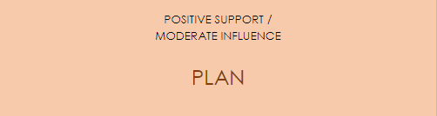
Cluster messages
  This group can become really helpful if you approach them correctly
  Goal: Move them to being more active
  Key Messages:
    “I know that being part of the family bank will turn out to be a good decision for you”
    “Can we talk about opportunities to get more involved? You have some really great skills that would be helpful.
    “I appreciate your willingness, is there anything I can do for you or your family?”
  Avoid: Overestimating support
Notes:
We know that it tends to be the same 5 or 10 people who do most of the work. but you have to have backups or people who could be willing to step up when needs must. This group might not be board ready just yet but could be mentors in the future if you play your cards right. You want to speak to their sense of self as responsible and helpful. But you don’t want to come in too heavy and assume that they are as committed as you are. Providing education over time will help them to feel confident that they know what the bank needs and slowly they will see their part in the bank

Slide 11
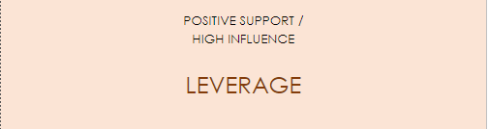
Cluster messages
  These are your cheerleaders. They have the potential to bring everyone else in
  Goal: Support, train, and get them embedded in the family bank
  Key Messages:
    “I’m grateful for your example, you’re doing a lot to make this possible”
    “Do you have ideas on how to reach some of the more resistant family members? I want to help them to see things the way you do.
    “Can I help you with any questions you’re having?”
  Avoid: Taking advantage of them
Notes:
This group is where you should spend a lot of time. They can become your board members and help drag the rest of the family with them. You want to acknowledge their work and time. It’s important to say that you value their time and skills. You also want to help them learn their roles.

Slide 12
Decision journeys
Awareness
Consideration
Commitment
Retention
Advocacy
Where the family member learns about the family bank and the change in plans.
This is where they weigh the costs and benefits of participating or not in the family bank
Here they decide to act on their position.
This could be taking on a role or deciding to oppose the bank
Do they stay with their original position or change their mind as time goes on..
Attempting to bring others to their side
Notes:
This is sample path of how a family member approaches the family bank. At each of these points, there are opportunities to influence their decision with the right message
awareness - how you tell them about the bank. while you can’t prevent every negative interaction, tailoring the introduction to the individuals and their concerns can reduce the negative reactions or create early support
consideration- this is likely the most important stage for intervention. You want to provide clarification and information so they can make decisions based on true information rather than first impressions.
commitment- it’ll be harder to influence them after they’ve committed. what you can do is guide the choice by offering an option or asking them to commit to a certain role or task
retention- this is your second chance. Over time someone’s feelings might have lessened and if you re approach with an update they could flip.
advocacy- no one likes to be alone. if you can’t move someone from being a detractor, you can try to encourage other members not to listen to them and lessen the impact of nay sayers.

Slide 13
Communication Opportunity
Awareness
  Plan individual meetings or small group meetings with likely high influence/high support people
  Plan shorter introductions with mid influence, mid support
  Invite low influence and lower support to larger group meeting
  Reach out to high influence, negative supporters. Ask for flexibility and grace
  Have shorter intros to mid influence, mid negative supporters, give them time to think
  Invite low influence and mild negative supporters to the larger group meeting
Notes:
You’ll want to spend the most time with the polar opposites on your spectrum of support. You want to diffuse the most negatives, and ask them to be more open minded. You want to reach out to your potential supporters and make them feel important and needed. Your inactive, low influence people might not need individual conversations. It’s best not to completely leave them out because you don’t want a sense of secrecy but they won’t need as much investment.
You don’t want to dive into an everybody meeting because it’s too many first reactions to handle at once. Once you feel like most people are at least willing to hear about it then a larger group meeting is a good idea.

Slide 14
Communication Opportunity
Consideration
  Plan follow up meetings with those who reacted most negatively
  Reassess and modify messages based on state objections
  Create education sessions to give your ambivalent people more information
  Reach out to non-attendees and offer to catch them up
  Start training your highest supporters for potential roles
Notes:
Depending on how your introduction goes, you might be in damage control mode. if not everyone is on board at first, that doesn’t mean you’ve failed. Consider it to be data. you know more about what they were thinking than you did before and you’ll need to speak to these concerns to move forward. Education sessions are a great tool to reassure those who are still on the fence.

Slide 15
Communication Opportunity
Commitment
  Ask highest supporters to commit to a role
  Ask detractors “Is there anything I can do to change your mind”
  Check in with the middle level supporters, see if they can be moved
  Express care for the inactive detractors, focus on relationship maintenance
Notes:
At this point the various positions might have settled a bit. this is where you’ll want to focus on the people who can help you the most as you’ll be moving further in establishing your bank.

Slide 16
Communication Opportunity
Retention
  Send updates to the disengaged people
  Keep your supporters excited about the project
  Thank your cheerleaders, celebrate their contributions
  Maintain relationships with detractors, keep offering education
Notes:
At this point the various positions might have settled a bit. this is where you’ll want to focus on the people who can help you the most as you’ll be moving further in establishing your bank.

Slide 17
Communication Opportunity
Advocacy
  Have your cheerleaders try to influence the family and build bridges
  Shut down detractors if they are getting more vocal
  Add opportunities to engage with the family bank at family events
  Share yearly report to share successes
Notes:
This is towards the end of the first year, you’ll want to celebrate the family bank and keep offering olive branches for those who aren’t on board yet. By now your board should be comfortable in their roles and they will take over the communication and education parts

Slide 18
NEXT STEPS
Fill out communication take home sheet to draft messages.
Create timeline of which family members you want to reach out to and when.
Start generating support for your bank.
Notes:
We’ve covered a lot today! Here’s what we need to next :

Slide 19
Your family bank is almost ready!
Notes:
[generate excitement and emphasize the progress that’s been made]

